Slide 1
Implementation and Evaluation of a Software Defined Radio Based Radiometer
Matthew E. Nelson
Iowa State University
Electrical and Computer Engineering

Slide 2
Acknowledgements
POS Committee
Dr. Phillip Jones, Dr. Brian Hornbuckle, Dr. John Basart
Additional Support
Dr. Mani Mina
Special Thanks
My wife Jennifer and my family for their support

Slide 3
Table of Contents
Introduction
Related Works
Background
Radiometer and SDR Basics
Implementation of a SDR-based Radiometer
Experimental Setup and Results
Example Usage Scenario
Closing

Slide 4
Introduction
Introduction
Related Works
Background
Implementation
Experimental Results
Example Usage Scenario
Closing
The goal of this presentation is to present my work in using software defined radio (SDR) technology to develop a radiometer that has performance on par with that of traditional radiometer. In addition to demonstrating a SDR-based radiometer can achieve similar performance, in terms of sensitivity and stability, as a traditional radiometer, it is shown that the inherent flexibility of SDR technology allows implementing functionality beyond what a traditional radiometer typically provides.
This thesis looks to explore the following questions:
Can we use a SDR to recreate a radiometer in software?
If so, what performance can we get from the system?
Can we create a low cost SDR Radiometer that is effective?
What benefits do we obtain by using a SDR Radiometer?

Slide 5
About the thesis
Introduction
Related Works
Background
Implementation
Experimental Results
Example Usage Scenario
Closing
Motivation:
Radiometry is used in a number of applications including:
Soil Moisture and Ocean Salinity (SMOS) satellite
Image courtesy of ESA
NRAO VLA
Image courtesy of NRAO/AUI
Notes:
SMOS was launched in November 2nd, 2009 by European Space Agency (ESA). It measures both soil moisture and ocean salinity using a radiometer at 1.4 GHz using a Microwave Imaging Radiometer with Aperture Synthesis (MIRAS). It uses both Vertical and Horizontal polarization.
The National Radio Astronomy Observatory is located in New Mexico. The VLA there uses cryogenics to keep the RXs cool. The signal is digitized and sent via fiber optics to a super computer to process the data.

Slide 6
Related Works
Introduction
Related Works
Background
Implementation
Experimental Results
Example Usage Scenario
Closing
Radio Astronomy
Radiometers are used in a variety of remote sensing applications such as soil moisture and ocean salinity
Radio Astronomy is one method of using radiometers for remote sensing
There are current stations using Software Defined Radios for Radio Astronomy
Notes:
Radiometers are used in remote sensing of soil, ocean and deep space. SMOS is an excellent example of a working soil and ocean measurement system.

Slide 7
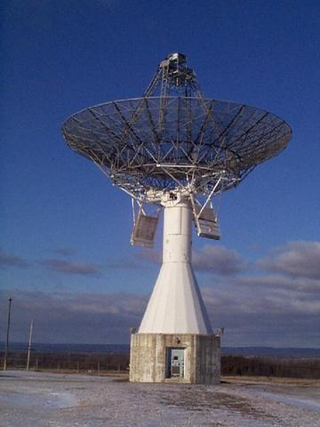
Related Works
Introduction
Related Works
Background
Implementation
Experimental Results
Example Usage Scenario
Closing
The Shirleys Bay Radio Astronomy Consortium (SBRAC) located in Smiths Falls, Ontario is currently using a USRP software defined radio in conjunction with GNURadio
Notes:
Marcus is the Principal Investigator at SBRAC and also a contributor to the radiometer branch in GNURadio. Although this branch is no longer maintained, he still answers questions about using radiometers with GNURadio SBRAC has successfully used this configuration to obtain radio astronomy data by looking at the hydrogen line at 1420.4058 MHz. The person in charge of this facility, Marcus Leech, contributed software to the GNURadio specifically for radio astronomy applications. It was this software branch that was used as the base for the GNURadio program that was used in this thesis.

Slide 8
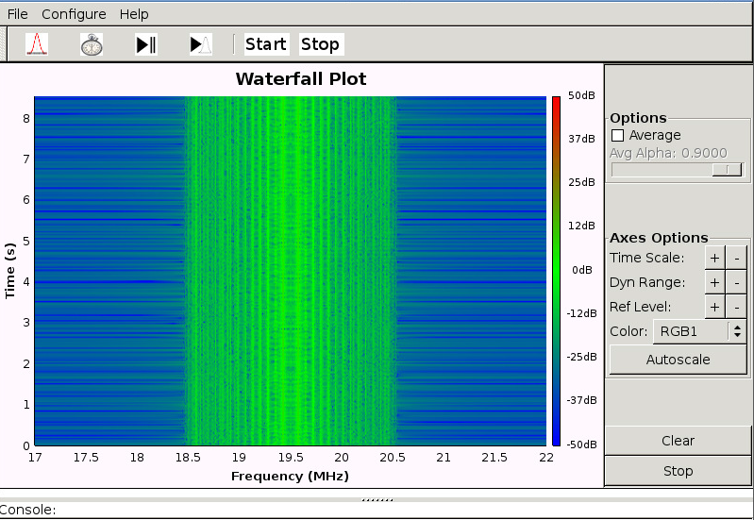
Related Works
Introduction
Related Works
Background
Implementation
Experimental Results
Example Usage Scenario
Closing
Students at the University of Illinois and Grand Valley State University built a software defined radio to listen to emissions from Jupiter by building their own RF section and using GNURadio for the software. This software defined radio was built using an Analog Devices AD9460 and a Xilinx Spartan-3E-500 FPGA to build the SDR itself.
Notes:
While the students in this paper built their own hardware, GNURadio was still used to develop the software. Another goal of this project was to produce a low cost solution using GNURadio.

Slide 9
SDR and Radiometer Basics
Introduction
Related Works
Background
Implementation
Experimental Results
Example Usage Scenario
Closing
The primary goal of a radiometer is to measure power. While that statement sounds easy, there are in fact many factors that go in to how well a radiometer can measure the power it sees. In order to accurately measure power, we need to keep the following in mind.
Total System Noise
Bandwidth of the signal
Stability of the system
Notes:
The primary goal of a radiometer is to measure power. While that statement sounds easy, there are in fact many factors that go in to how well a radiometer can measure the power it sees. A better statement would be that a radiometer’s primary goal is to accurately measure power within a certain degree of accuracy. In order to accurately and within a high degree of precision measure power, a radiometer must take into account various factors such as the system noise, the bandwidth of the signal and the stability of the system as a whole.

Slide 10
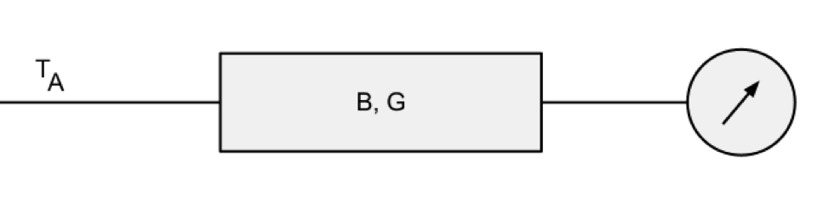

SDR and Radiometer Basics
Introduction
Related Works
Background
Implementation
Experimental Results
Example Usage Scenario
Closing
A very simple and ideal radiometer is an antenna that amplifies a signal with a gain of G and is within a bandwidth of B or $β$. A device then measures the power from this system. The total power received by the is the noise temperature of the object it is pointed at. Therefore the brightness temperature of the source can be related to the brightness temperature at the antenna. We will refer to this brightness temperature as T_{A}
Notes:
To measure power we begin with the noise signal coming from the antenna. Our antenna is assumed to be looking at our target of interest and it is assumed that we can relate the antenna noise to the noise from the source. It is often easier to refer to this noise as the brightness temperature. Therefore the brightness temperature of the source can be related to the brightness temperature at the antenna. We will refer to this brightness temperature as TA

Slide 11
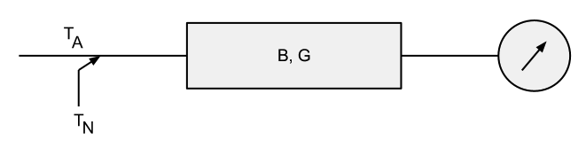
SDR and Radiometer Basics
Introduction
Related Works
Background
Implementation
Experimental Results
Example Usage Scenario
Closing
A more realistic model is a system that includes the noise that is generated by the radiometer itself. This noise is added to the noise from the antenna.
Notes:
The antenna itself also adds noise. Our greatest contributor to noise is from the LNAs. However mismatches in the RF chain and other factors can also increase this noise. This noise covers up or obscures the noise that we are interested in so we want to keep this to a minimum.

Slide 12
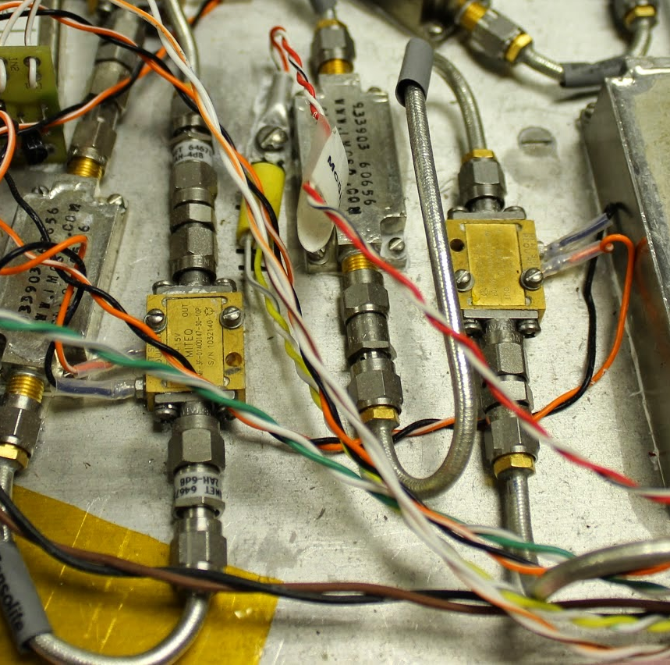
SDR and Radiometer Basics
Introduction
Related Works
Background
Implementation
Experimental Results
Example Usage Scenario
Closing
The RF front end is one of the most critical components in a radiometer, both traditional and in our software defined radio setup. Although we have moved many components to be emulated in software, one component, the Low Noise Amplifier (LNA) can not be emulated in software. LNAs amplify our signal to increase our sensitivity while keeping as low as possible the noise it contributes to the system.

Slide 13
SDR and Radiometer Basics
Introduction
Related Works
Background
Implementation
Experimental Results
Example Usage Scenario
Closing
A software defined radio (SDR) is designed to mimic radio functions in software instead of using dedicated hardware. A radiometer is a radio that can detect changes in power. Therefore the SDR needs to be able to measure power coming from the source that we are looking at.
Notes:
Software defined radios have been used in a number of applications, but usually related to communication systems. Changes to modulation and encoding/decoding is very easy for a SDR and this is why SDRs have grown in recent years. Use in remote sensing applications, as far as I know, is a relatively new application of SDRs.

Slide 14
SDR and Radiometer Basics
Introduction
Related Works
Background
Implementation
Experimental Results
Example Usage Scenario
Closing
To build a radiometer in software, we need to know what components are key to the radiometer and build them in software. There are four key components we can build in software.
Filter to the bandwidth we desire
Total power measurement
Integration
Record the data
Notes:
Filtering can be done by limiting the sampling rate of the SDR, but we can also add additional filtering if desired.

Slide 15
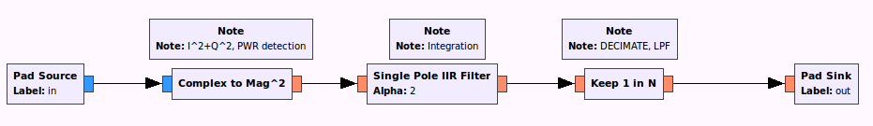
Software Defined Radio
Introduction
Related Works
Background
Implementation
Experimental Results
Example Usage Scenario
Closing
Total power measurements is accomplished by squaring the phase and magnitude information provided by the SDR. Integration is a simple mathematical operation on the signal Recording the data is also trivial for the software to accomplish
Notes:
The block shown is the TPR block we used in GNURadio. This combines the total power measurement and integration and low-pass filter into one block that we can call in other programs.

Slide 16
Comparison
Introduction
Related Works
General Radiometer Theory
Software Defined Radio Theory
Experimental Results
Closing
Traditional Radiometer
A traditional radiometer uses Low Noise Amplifiers, hardware based filters and a square-law detector to measure the total power received.
SDR Radiometer
A software defined radiometer eliminates the filters and the square-law detector and replaces this with their mathematical equivalents that is emulated in software.
Notes:
SDRs can filter in two ways. First, by limiting the sampling rate we effectively put a bandwidth filter on the system. Two, we can also filter by constructing a filter in software, although there is some cost with this option in terms of CPU and memory requirements on the system

Slide 17
Comparison
Introduction
Related Works
General Radiometer Theory
Software Defined Radio Theory
Experimental Results
Closing
Traditional Radiometer
Most total power radiometers do not retain any frequency information, this information is lost and in most cases can not be recovered.
SDR Radiometer
Since we have both magnitude and phase information we can recreate the signal or manipulate it as needed. This allows for more in-depth analysis such as RFI mitigation.
Notes:
SDRs give us a lot more information to work with. At the core of a radiometer, this information is not needed which is why it was often discarded. However, several papers have now been written that bring to light the need for additional information in order to deal with known issues with radiometers such as interference or new methods for determining total power such as the Stokes method. A key thing with a SDR radiometer is that in many ways it flexible enough to handle any future methods with either very little or no change in hardware.

Slide 18
Implementation
Introduction
Related Works
General Radiometer Theory
Software Defined Radio Theory
Experimental Results
Closing
A total power radiometer in software requires us to extract the magnitude (or amplitude) information from the I/Q data captured. This is equivalent to what a square-law detector does in determining the power measured.
Notes:
Unlike an analog radiometer, the magnitude information is there and a simple squaring gives us total power. A square-law detector however has to do just that, it detects the power and then extracts that as a voltage.

Slide 19

Implementation
Introduction
Related Works
General Radiometer Theory
Software Defined Radio Theory
Experimental Results
Closing
For the SDR, the incoming signal is sampled and converted to I/Q values. The I/Q values represent the in-phase (i.e I) and the quadrature phase (i.e. Q) of the signal. In GNURadio we are then able to square these values within software. This block in GNURadio mathematically performs the following:
$$I^{2}+Q^{2}=P_{out}$$

Slide 20
Filtering
Introduction
Related Works
General Radiometer Theory
Software Defined Radio Theory
Experimental Results
Closing
Filtering requirements in a software defined radio is different from a hardware based or traditional radiometer.
The bandwidth setting of the SDR only samples data within that bandwidth
Additional filters can be added at a cost of additional processing requirements
Because filtering is software driven, filters can be added or removed with no additional hardware required.

Slide 21
Integration
Introduction
Related Works
General Radiometer Theory
Software Defined Radio Theory
Experimental Results
Closing
The data we get from these power measurements fluctuate very quickly. We want to smooth out or filter this data by integrating this over time. In a traditional radiometer a hardware integrator is often used. In software, we can use an Infinite Impulse Response (IIR) filter as an integrator.

Slide 22

IIR as an integrator implementation
Introduction
Related Works
General Radiometer Theory
Software Defined Radio Theory
Experimental Results
Closing
It can be seen that an IIR filter can have the same frequency response as we would expect from an analog RC filter. As our sampling rate approaches infinity, the approximation gets closer to the original response from the analog RC circuit.
$$y_{n}= \frac{T}{T+RC}x_{n}+\frac{RC}{T+RC}y_{n−1}$$

Slide 23
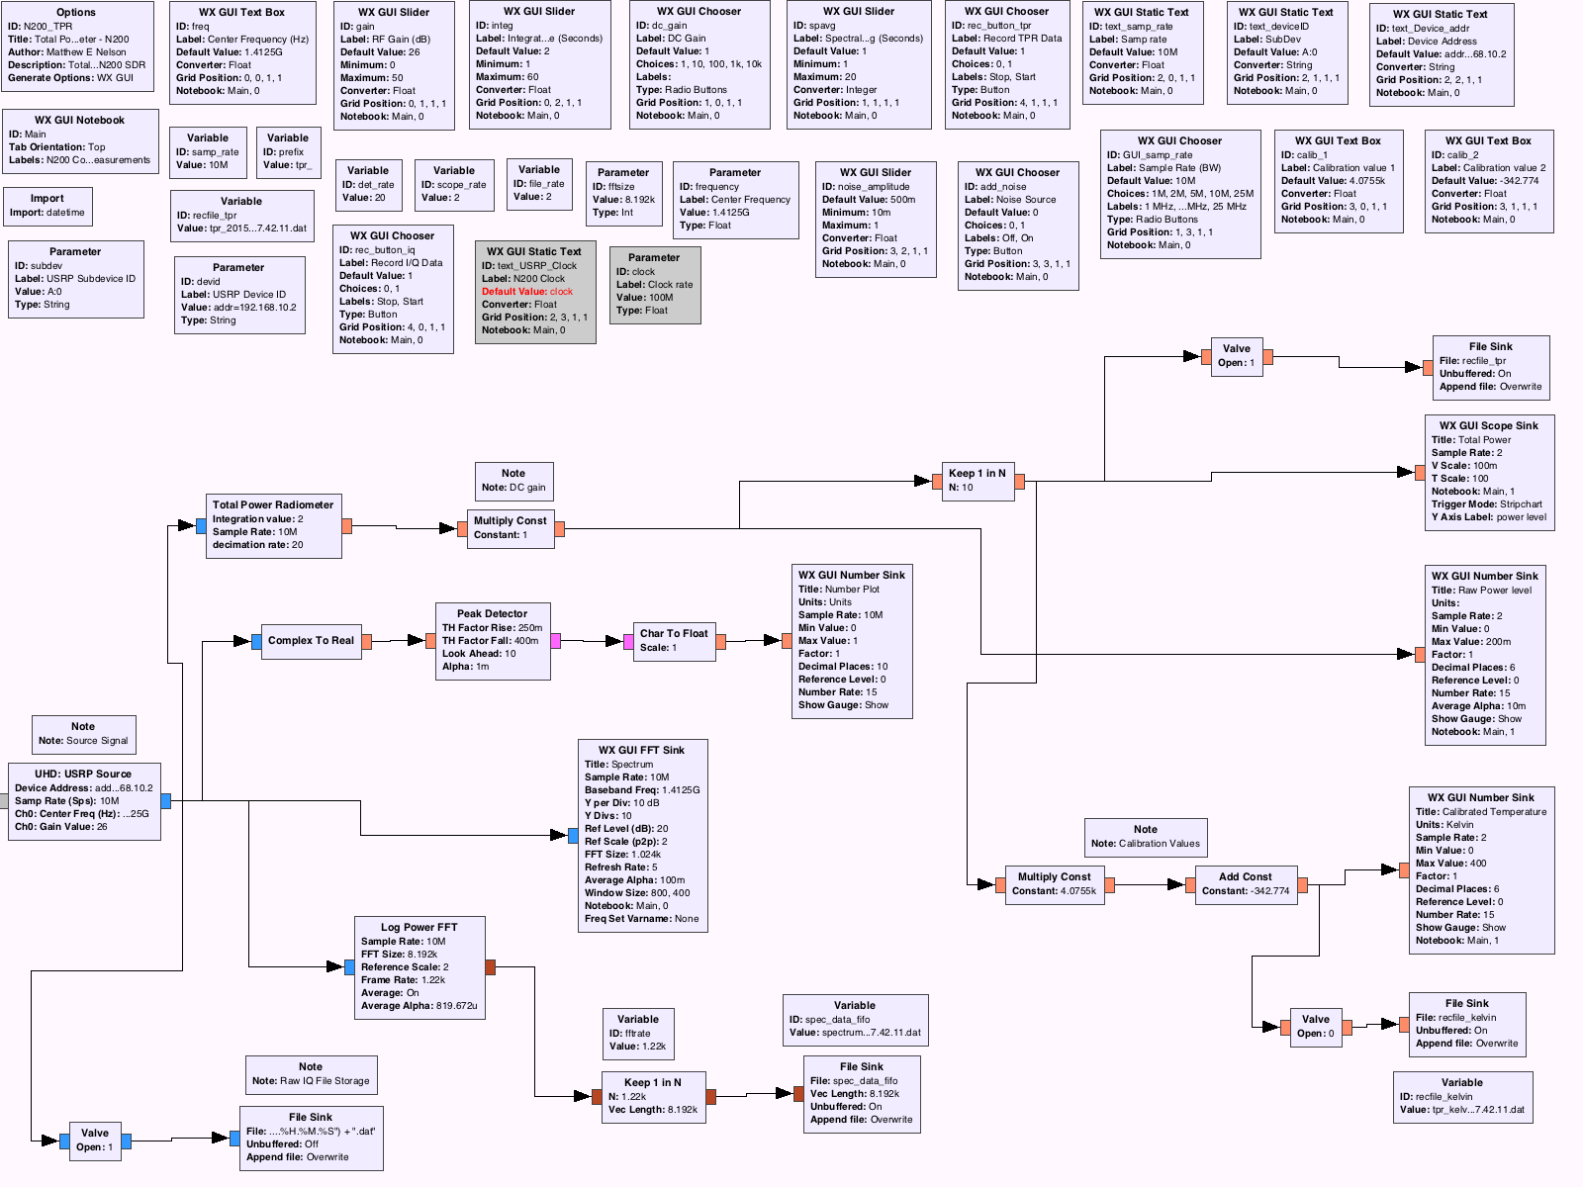
Implementation in SDR
Introduction
Related Works
General Radiometer Theory
Software Defined Radio Theory
Experimental Results
Closing

Slide 24
Implementation in SDR
Introduction
Related Works
General Radiometer Theory
Software Defined Radio Theory
Experimental Results
Closing
In GNURadio, we begin with our source block. The source block provides the I and Q data that we can use in our signal processing. In our case, the source block communications with the N200 SDR over a Gigabit Ethernet connection. We also communication back to this block to set the bandwidth, frequency and gain values for the onboard PGA.

Slide 25
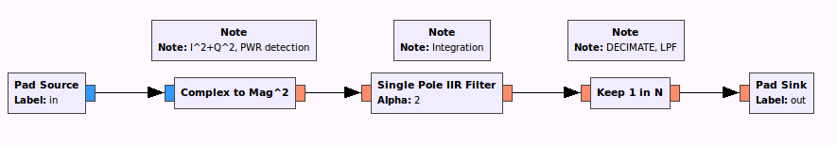
Implementation in SDR
Introduction
Related Works
General Radiometer Theory
Software Defined Radio Theory
Experimental Results
Closing
Power Detection
Integration
Low Pass Filter

Slide 26
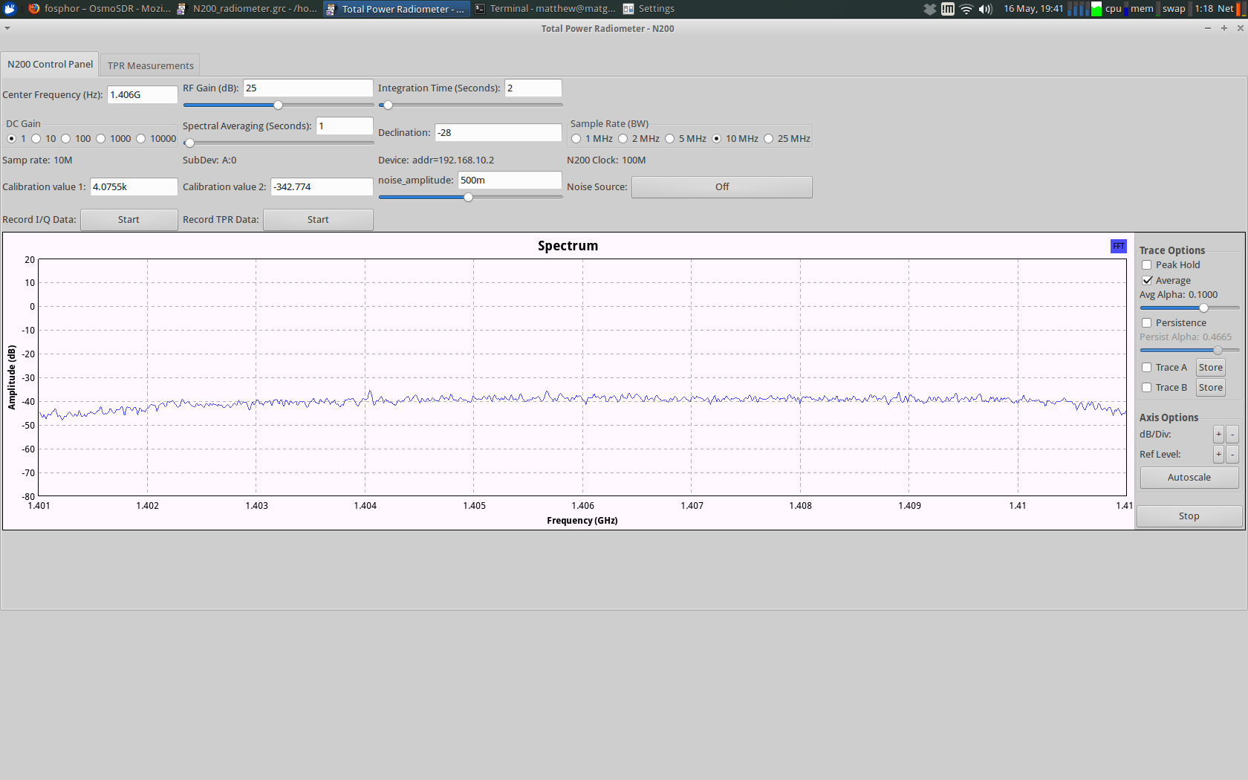
GUI for Radiometer
Introduction
Related Works
General Radiometer Theory
Software Defined Radio Theory
Experimental Results
Closing

Slide 27
Example Usage Scenario
Introduction
Related Works
Background
Implementation
Experimental Results
Example Usage Scenario
Closing
Application Scenario: Soil Moisture reading with interfering signal
A radiometer is deployed in a field to take soil moisture readings
Data is recorded with the SDR-based radiometer. Both total power and the I and Q data is saved
After the experiment, the data is examined. The data is inconsistent and indicates a problem. Further analysis is needed

Slide 28
Example Usage Scenario
Introduction
Related Works
Background
Implementation
Experimental Results
Example Usage Scenario
Closing
The I/Q data is played back and examined on the spectrum analyzer window of our program. An interfering signal can clearly be seen at 1.406 GHz
A filter is designed in GNURadio to notch out the offending signal

Slide 29
Example Usage Scenario
Introduction
Related Works
Background
Implementation
Experimental Results
Example Usage Scenario
Closing
The data needs to be re-calibrated since we have lost some bandwidth to the filter
The experiment is played back through GNURadio but with the filter turned on
New total power measurements are then made resulting in the correct data obtained

Slide 30
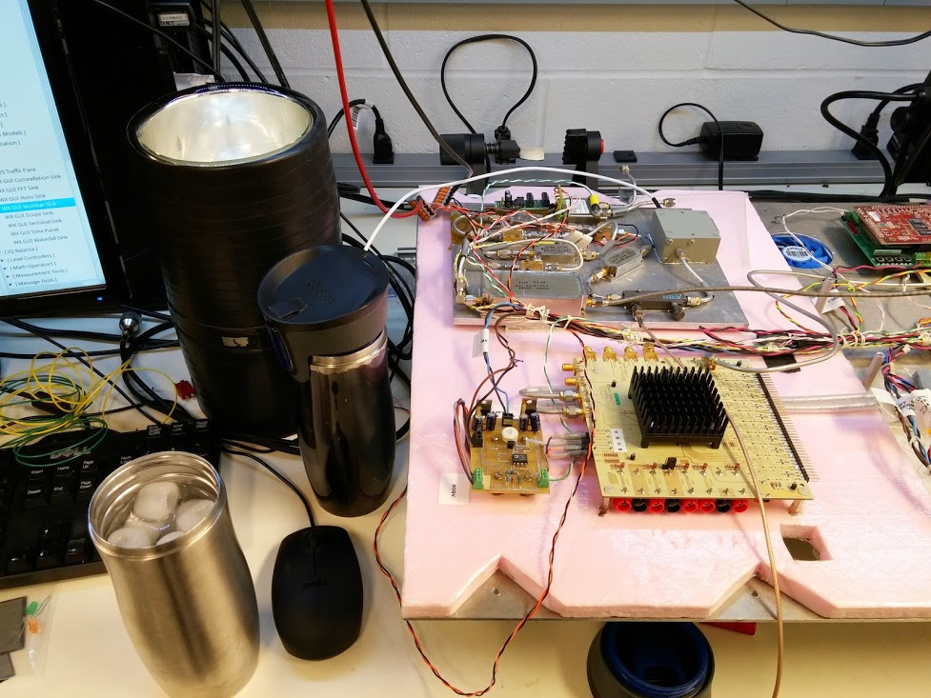
Experimental Data
Introduction
Related Works
General Radiometer Theory
Software Defined Radio Theory
Experimental Results
Closing
Experimental data was collected to verify the operation of a software defined radio as a radiometer and to test additional capabilities that a traditional radiometer may not be able to do.

Slide 31
Experiment 1 – Normal Operation
Introduction
Related Works
General Radiometer Theory
Software Defined Radio Theory
Experimental Results
Closing
Experiment compares the operation of a software defined radio radiometer to a traditional radiometer. This compares data collected from the SDR to a square-law detector. Data is collected and the data is calibrated to known noise temperatures by submerging a 50-ohm matched load into two known baths. We will use ice water and Liquid Nitrogen (LN2) for our baths

Slide 32
Extra Slides
Introduction
Related Works
General Radiometer Theory
Software Defined Radio Theory
Experimental Results
Closing
It should be noted that all graphs generated for these experiments was generated using Python. More specifically they were generated using iPython Notebook, which allows the author to easily run python code within a browser and share the results as a web page. This experiment for example can be found on the author’s webpage located here
All code, LaTeX, and supporting documents can also be found on the author’s GitHub page, located here:

Slide 33
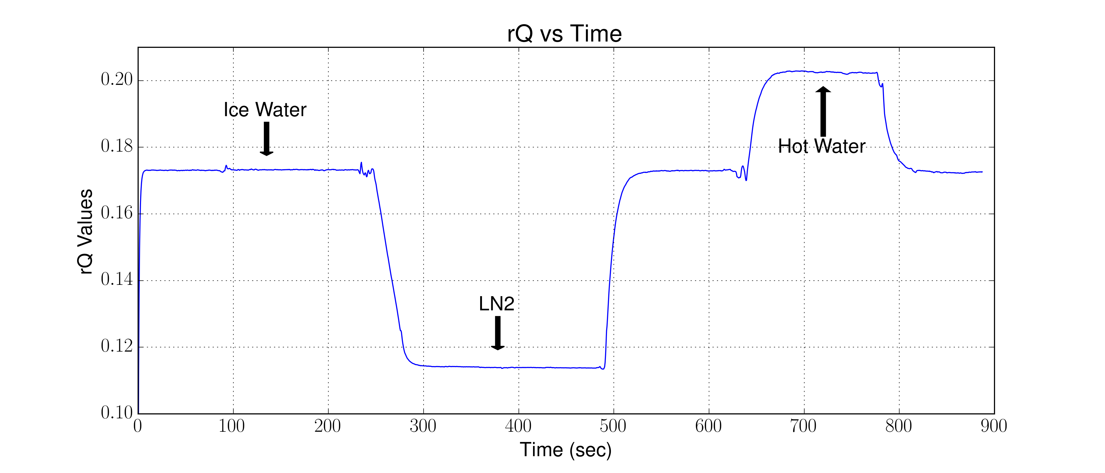
Experiment 1 – Normal Operation
Introduction
Related Works
General Radiometer Theory
Software Defined Radio Theory
Experimental Results
Closing
Let’s begin by looking at the software defined radio, and we will look for now at the rQ values recorded.

Slide 34
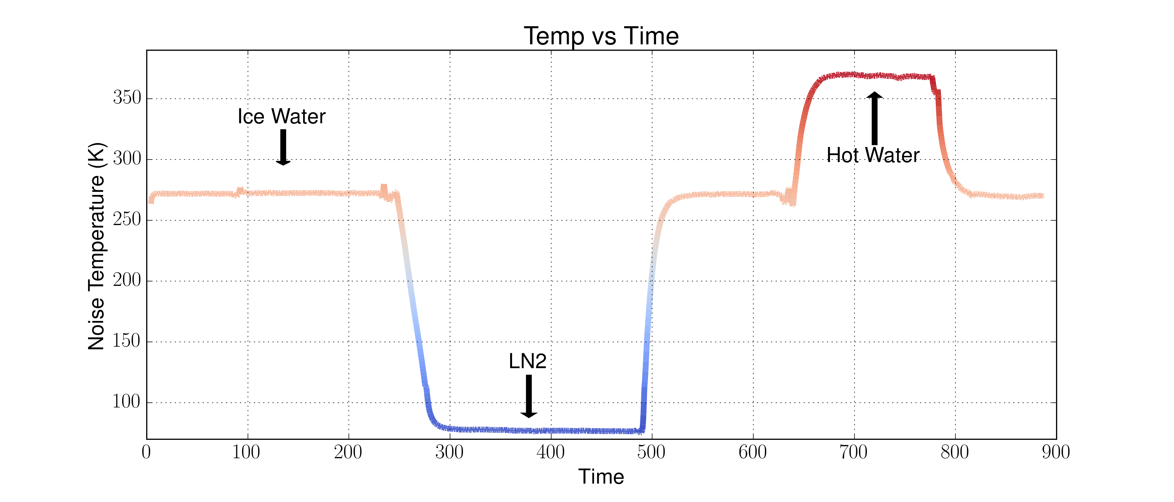
Experiment 1 – Normal Operation
Introduction
Related Works
General Radiometer Theory
Software Defined Radio Theory
Experimental Results
Closing
This data is not calibrated, since we have at least two points, we can calibrate this.

Slide 35
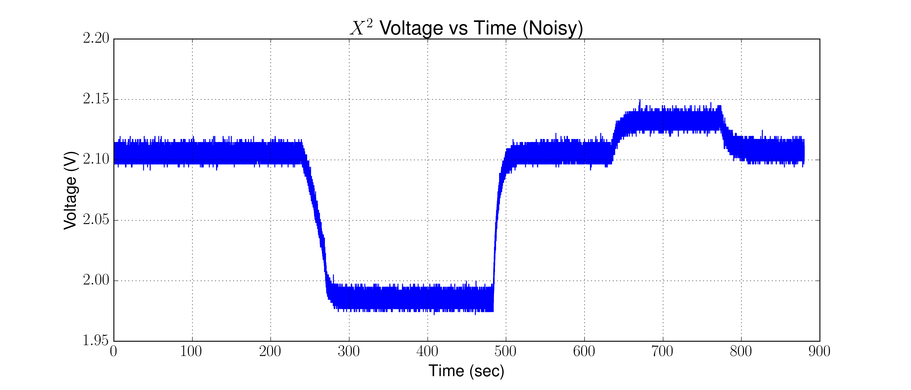
Experiment 1 – Normal Operation
Introduction
Related Works
General Radiometer Theory
Software Defined Radio Theory
Experimental Results
Closing
The SDR appears to be making correct measurements, but let’s look at the square-law

Slide 36
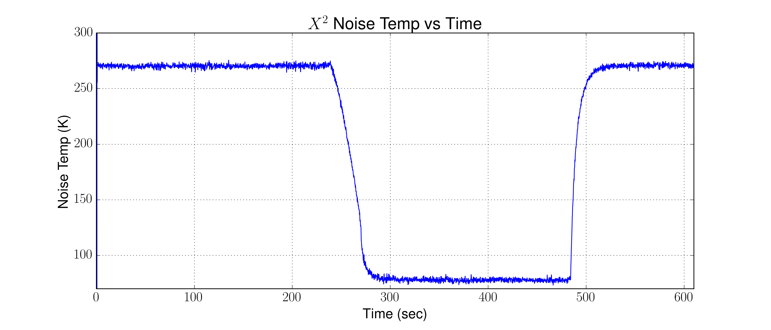
Experiment 1 – Normal Operation
Introduction
Related Works
General Radiometer Theory
Software Defined Radio Theory
Experimental Results
Closing
The square-law is pretty noisy. However, we can apply a low pass filter to our data and also calibrate it.

Slide 37
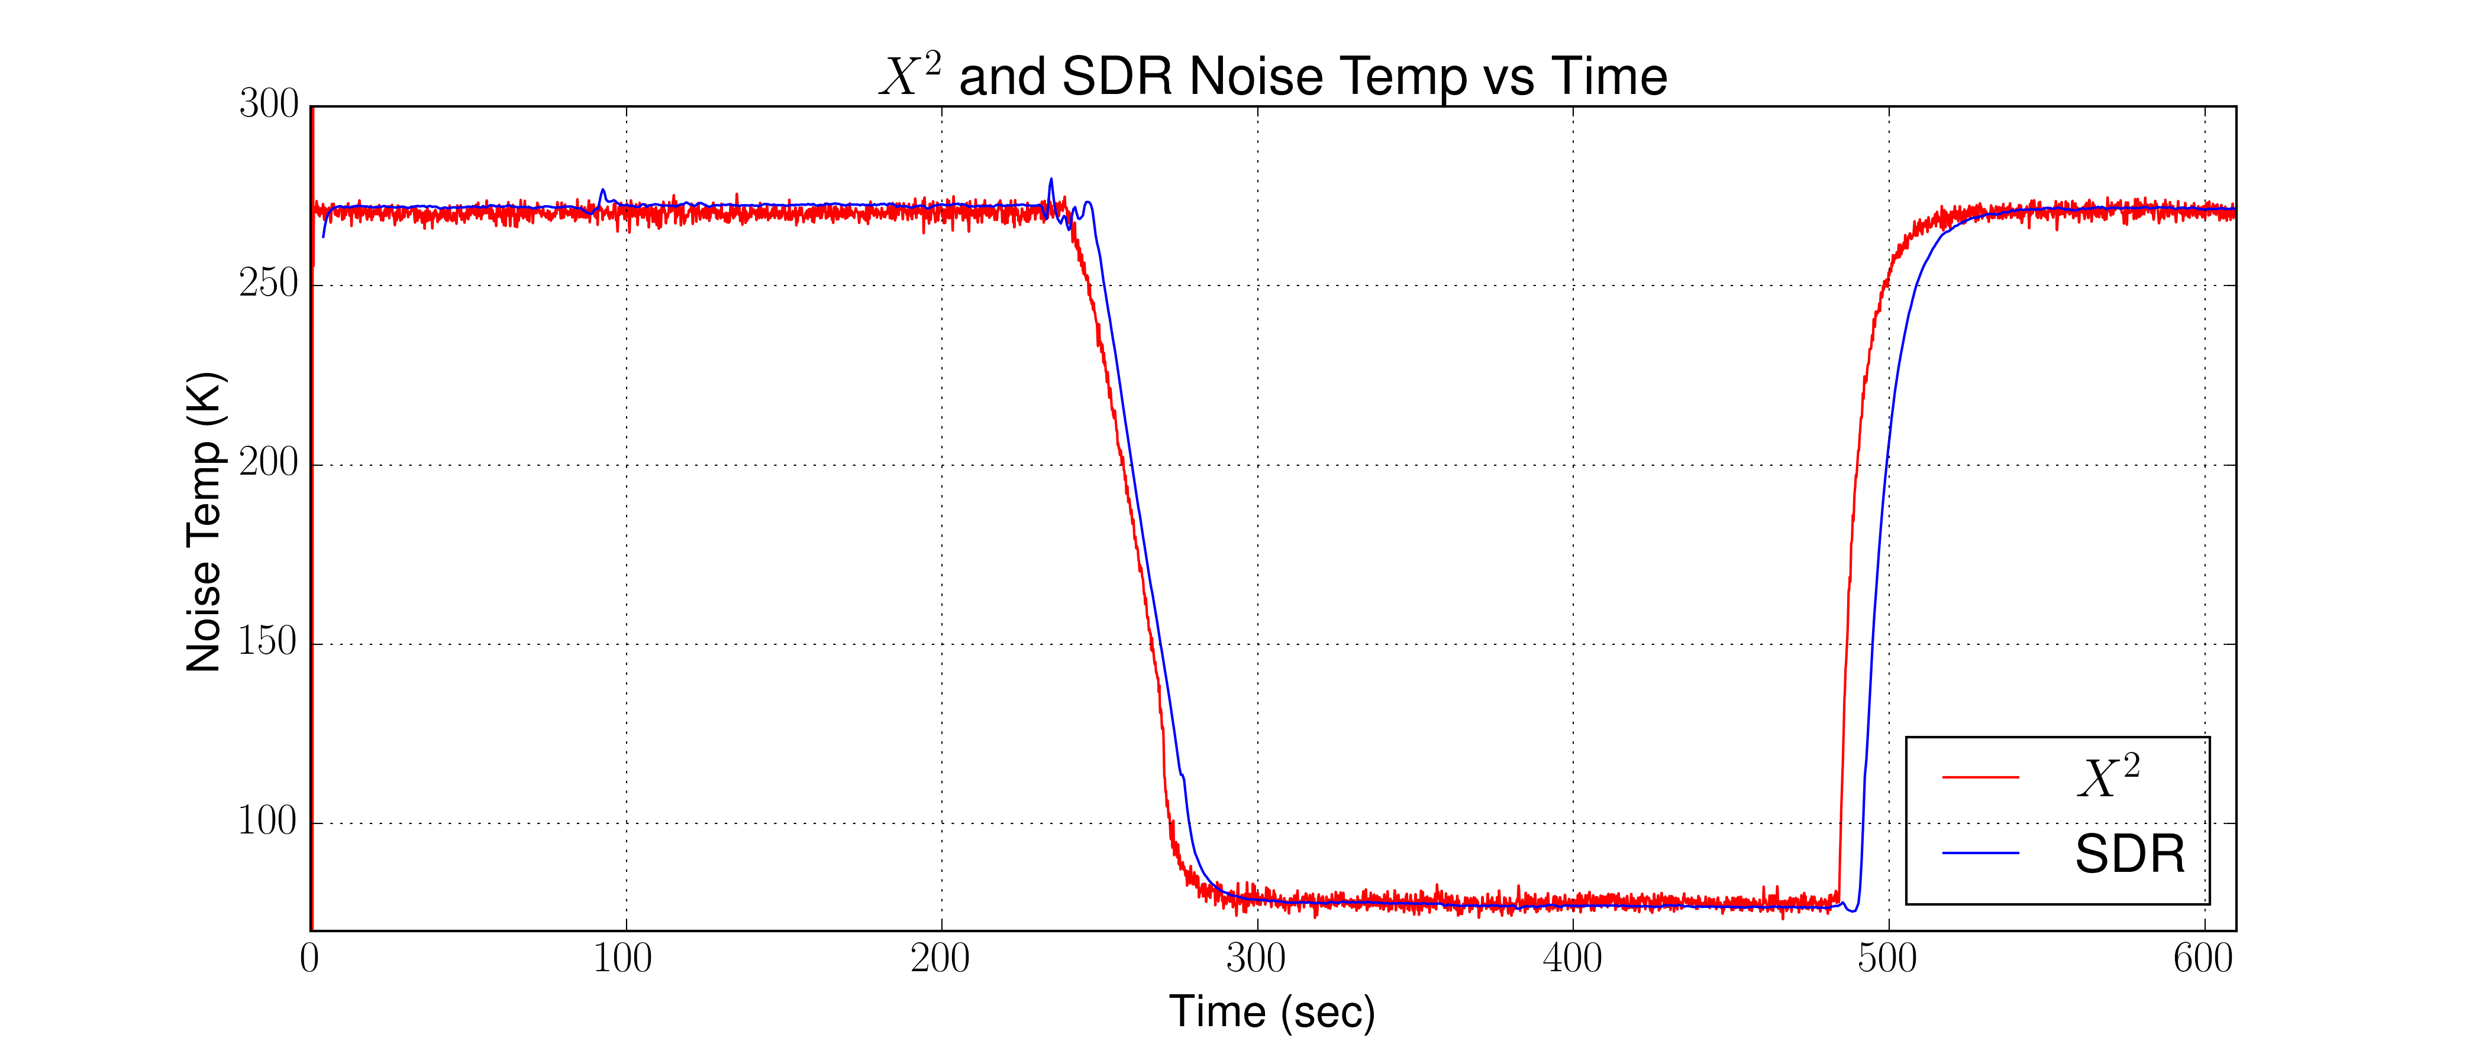
Experiment 1 – Normal Operation
Introduction
Related Works
General Radiometer Theory
Software Defined Radio Theory
Experimental Results
Closing
Again, this looks good, but let’s put them one on top of each other to verify

Slide 38
Experiment 1 – Normal Operation
Introduction
Related Works
General Radiometer Theory
Software Defined Radio Theory
Experimental Results
Closing
Experiment one verified that once calibrated, both the software defined radio and the square-law detector are in agreement. This shows that the SDR can indeed function as total power radiometer as we would expect from a traditional radiometer using a square-law detector

Slide 39
Experiment 1 – Normal Operation
Introduction
Related Works
General Radiometer Theory
Software Defined Radio Theory
Experimental Results
Closing
Let’s now look if we calibrated to soil moisture reading. Since we are not using an antenna, we can not look at a real sample. However, we can pretend using our calibration points. This also brings up another feature of the SDR, the waterfall display that can also give us a visual of the signal we are looking at.

Slide 40
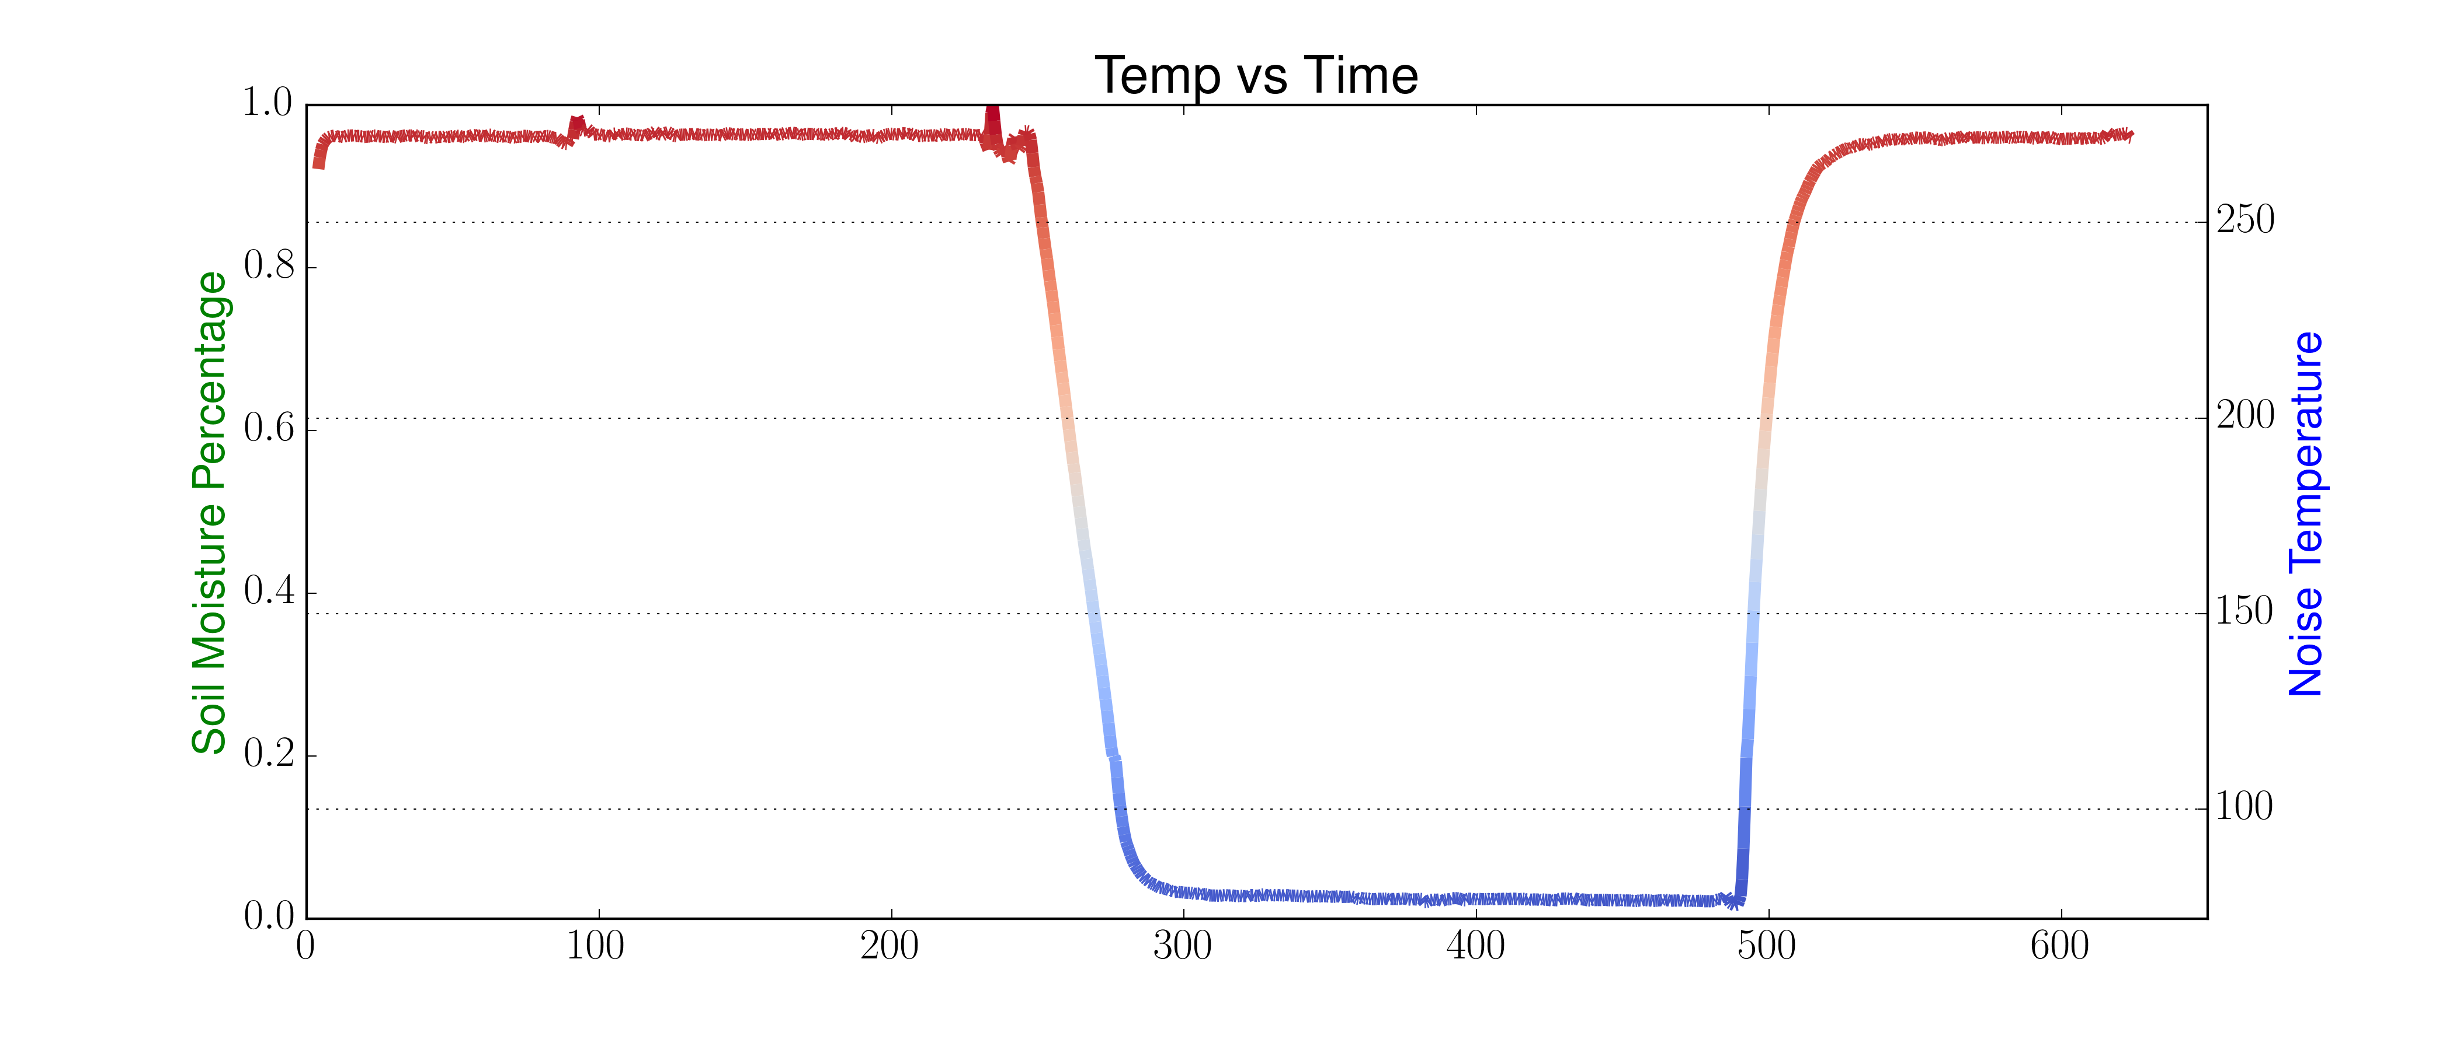
Experiment 1 – Normal Operation
Introduction
Related Works
General Radiometer Theory
Software Defined Radio Theory
Experimental Results
Closing
Let’s begin with saying that LN2 will be our “wet” or have a cooler noise temperature and our ice water will be our “dry” or warmer noise temperature.

Slide 41
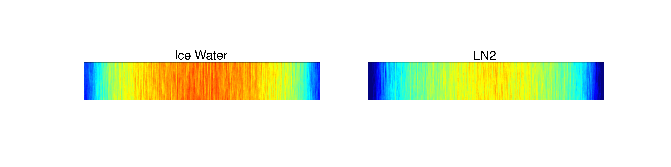
Experiment 1 – Normal Operation
Introduction
Related Works
General Radiometer Theory
Software Defined Radio Theory
Experimental Results
Closing
Another visual aid is the waterfall display that is part of GNURadio. Let’s look at the same data with the waterfall display.
We can see the “warmer” noise temperature in the ice water on the left and the “cooler” noise temperature with the LN2 on the right

Slide 42
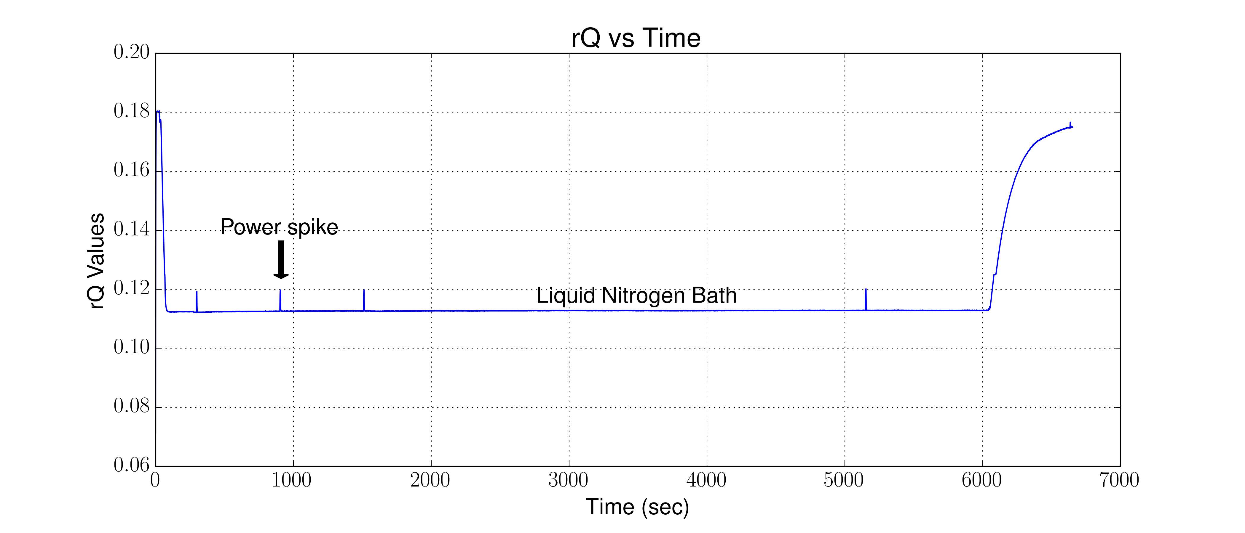
Experiment 2 – Stability
Introduction
Related Works
General Radiometer Theory
Software Defined Radio Theory
Experimental Results
Closing
Another test for the radiometer is looking at the stability of the system. Most of the stability we are concerned with falls with the LNAs that we use. However, we want to verify our system is stable with the addition of the SDR now.

Slide 43
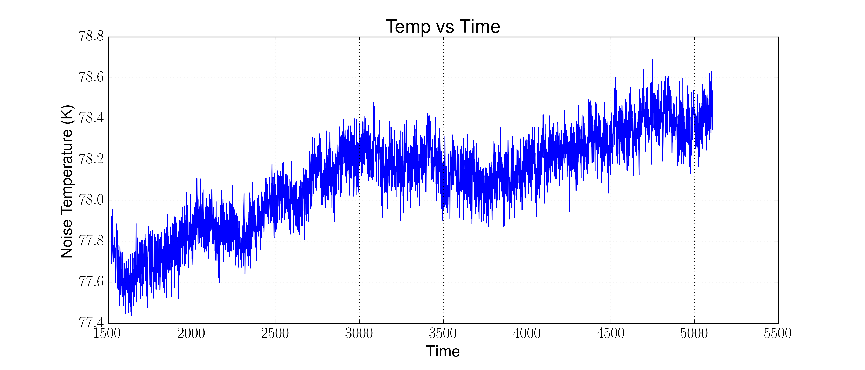
Experiment 2 – Stability
Introduction
Related Works
General Radiometer Theory
Software Defined Radio Theory
Experimental Results
Closing
To avoid some of the “spikes” we will choose a 62 min block that was error free.

Slide 44
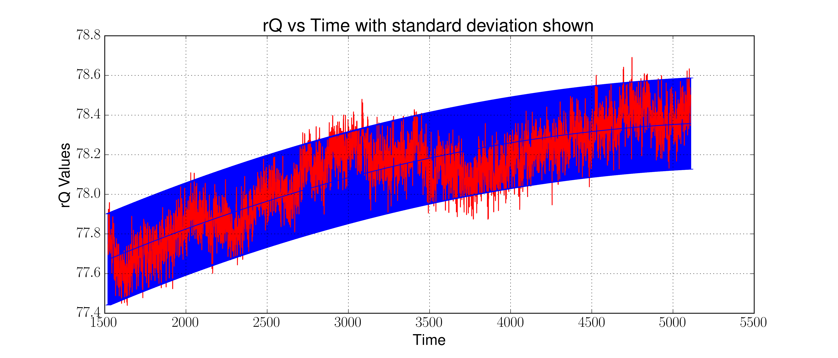
Experiment 2 – Stability
Introduction
Related Works
General Radiometer Theory
Software Defined Radio Theory
Experimental Results
Closing
We found by doing a standard deviation that we did not change more than .23 K and over the period of time we had a total change of .8 K

Slide 45
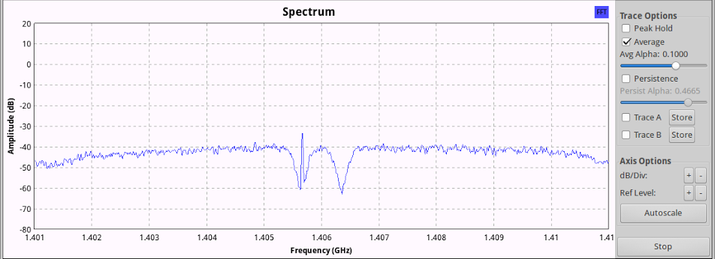
Experiment 3 – Noise Rejection
Introduction
Related Works
General Radiometer Theory
Software Defined Radio Theory
Experimental Results
Closing
In Experiment three we wanted to do something that would prove an advantage of the SDR over a traditional radiometer. A traditional radiometer does not have any methods to mitigate interference since it loses frequency information. With the SDR, we keep the frequency information and we can identify an remove an offending signal

Slide 46
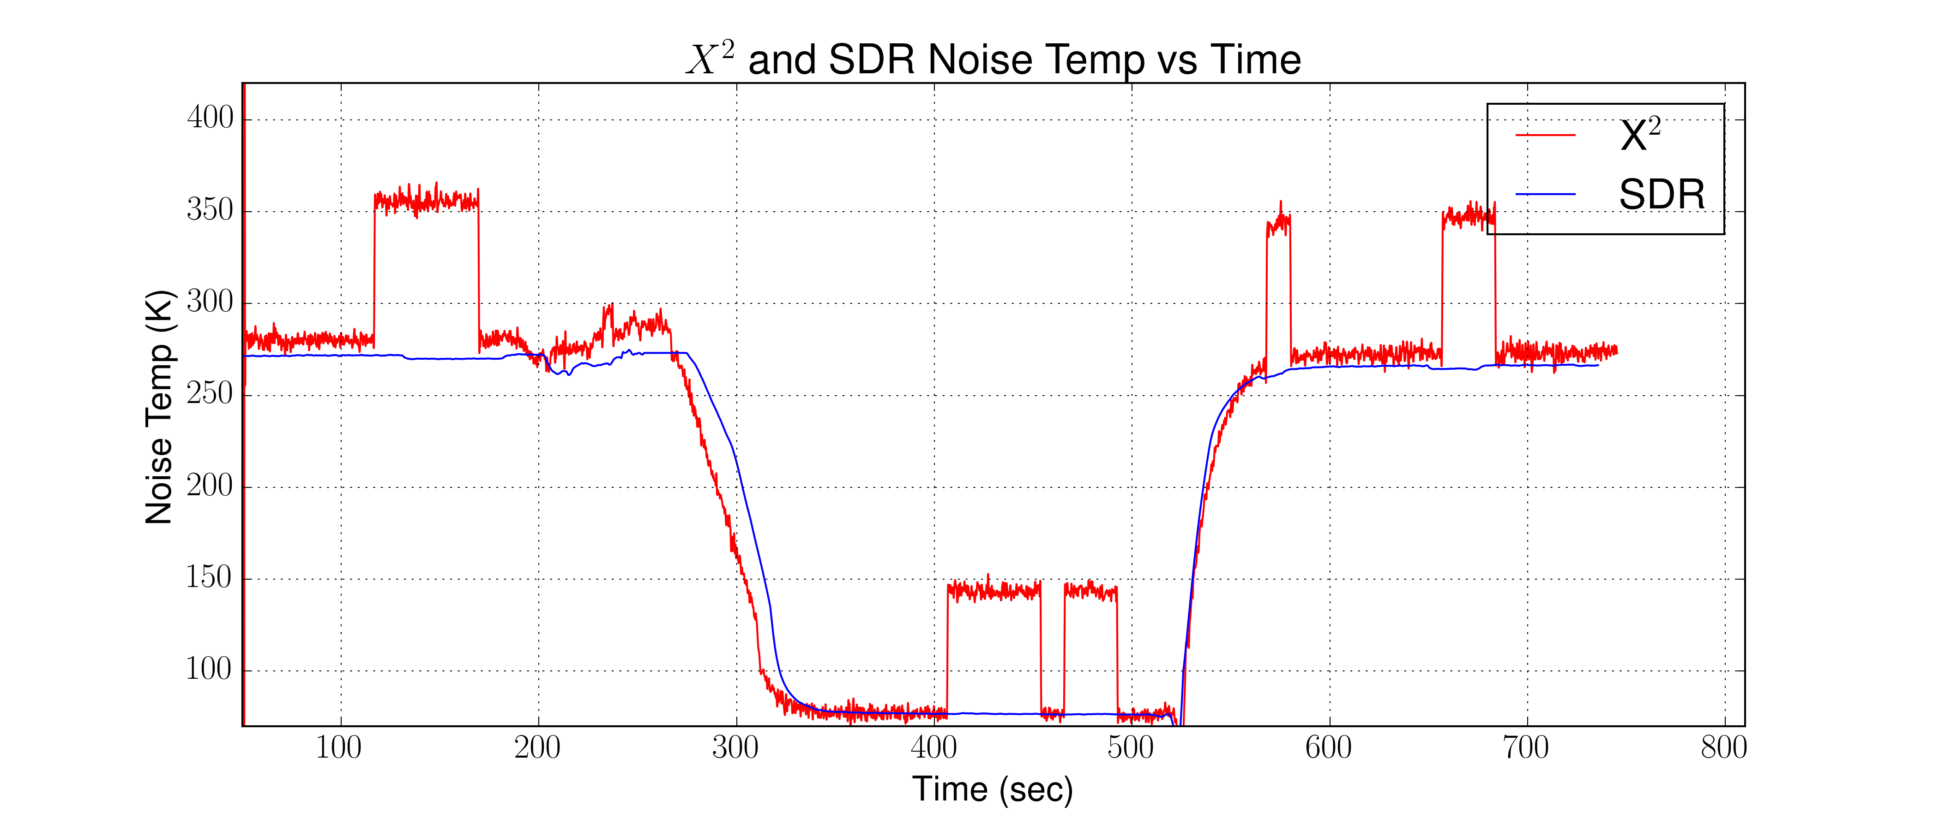
Experiment 3 – Noise Rejection
Introduction
Related Works
General Radiometer Theory
Software Defined Radio Theory
Experimental Results
Closing
Here we can both the SDR and square-law on top of each other again. However, the SDR is filtering the offending signal.

Slide 47
Conclusion
Introduction
Related Works
General Radiometer Theory
Software Defined Radio Theory
Experimental Results
Closing
In this thesis we have shown that an off the shelf SDR can be used to perform as a radiometer. Using a SDR has several advantages such as a more flexible system and can result in a less expensive system. Since a SDR offers high flexibility, changes to the system can be done very quickly and helps in future proofing the system.

